Slide 1
MATLAB CODES FOR RANGE AND VELOCITY MEASUREMENTS
Job Mattew George

Slide 2
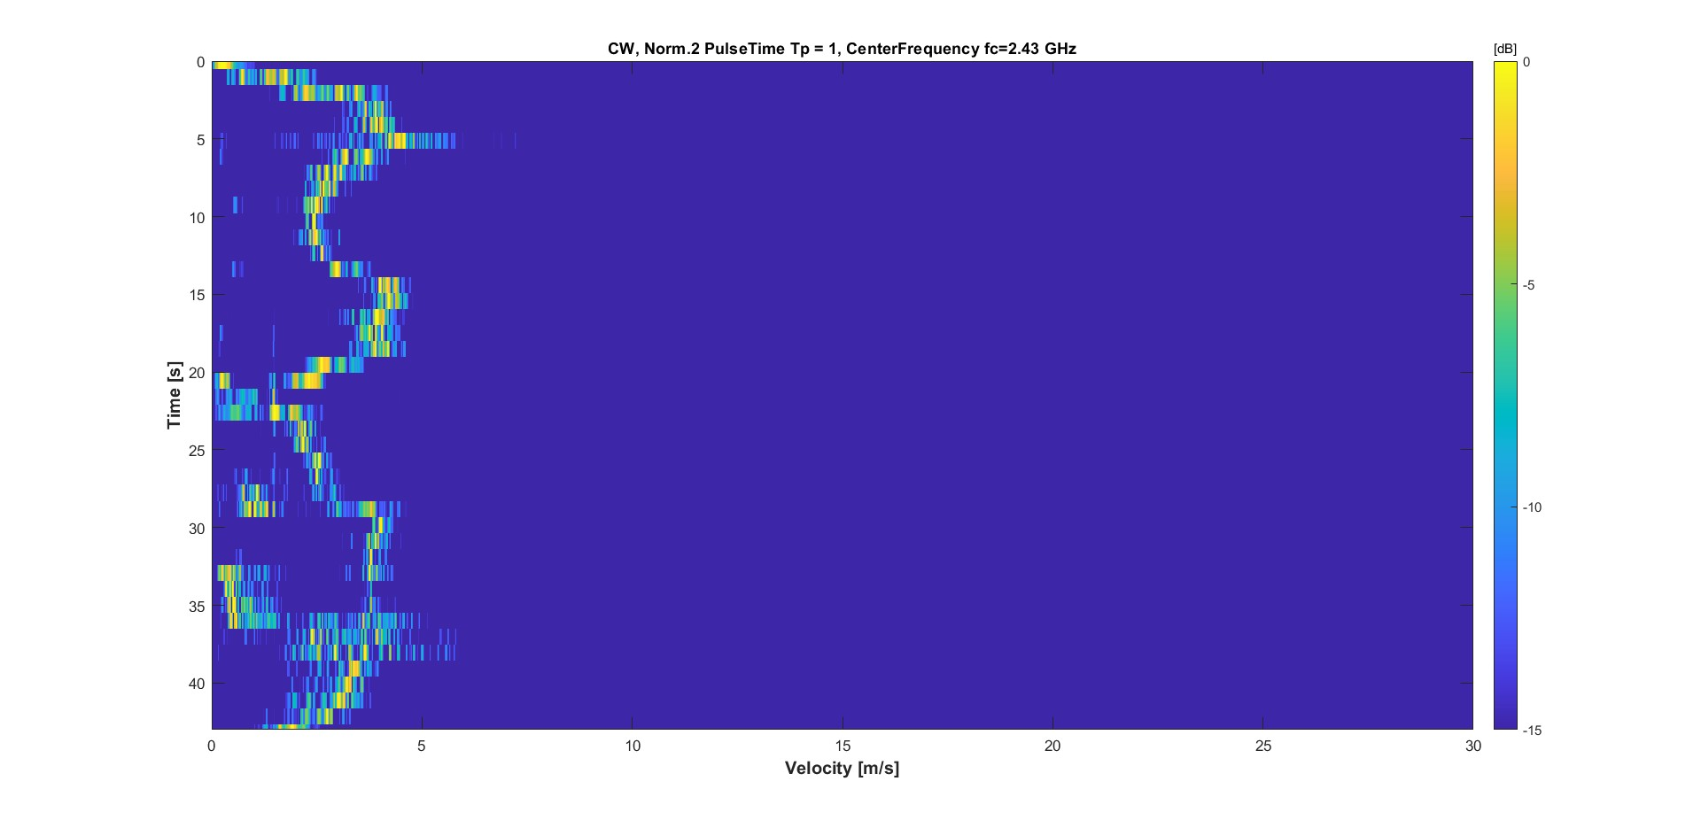
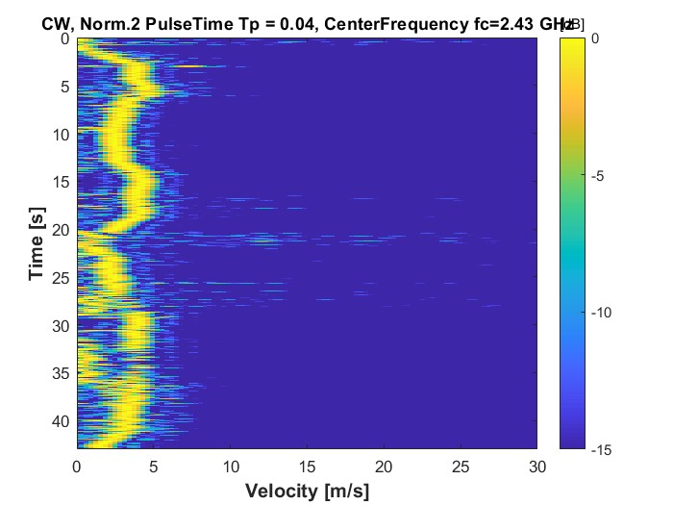
VELOCITY IMAGES TEST FOR CW RADAR
Some important parameters to be considered :
Tp pulse width
fc carrier frequency
Sampling Frequency
Total Observation Time
These parameters play a pivotal role in mapping out the results we obtain from the radar.
Variation of the Pulse width (Tp) :
Long Tp duration
Short Tp Duration
Higher frequency resolution,
lower time resolution.
Lower frequency resolution,
higher time resolution.
TRADE-OFF
Notes:
Tp pulse width: Observation time of the FFT algorithm. The audio file is quantized in windows of duration Tp, the longer is Tp the narrower is the window bandwidth. This allows us to have better accuracy as the velocity is a shift in frequency of the carrier frequency.
fc carrier frequency: it determines the maximum range of the radar and it is fundamental in the conversion of Doppler frequency to the relative velocity between the target and the radar.
Sampling Frequency: This parameter also defines the bandwidth of the Fast Fourier Transform (FFT).
Total Observation Time: This parameter is pivotal as it determines the achievable frequency resolution
Long window duration Tp resulting in a worse time resolution, but less frequency uncertainty.
Short window duration Tp resulting in high frequency uncertainty, but very good time resolution.

Slide 3
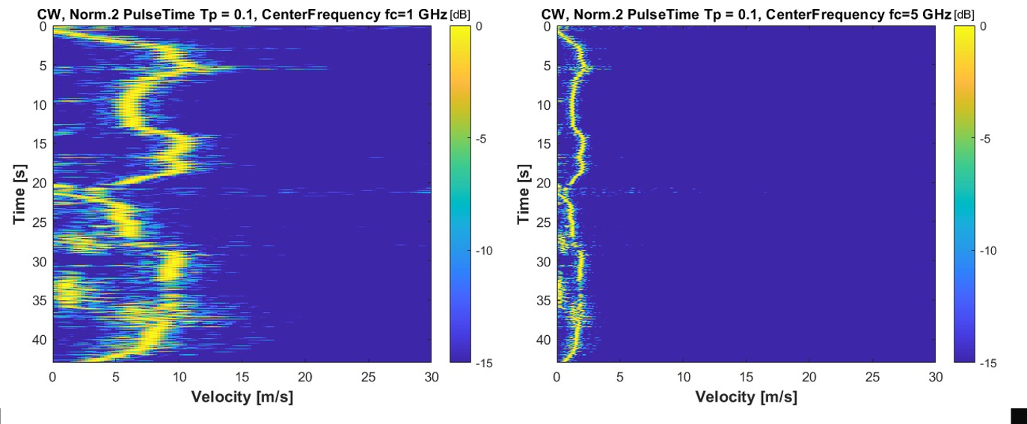
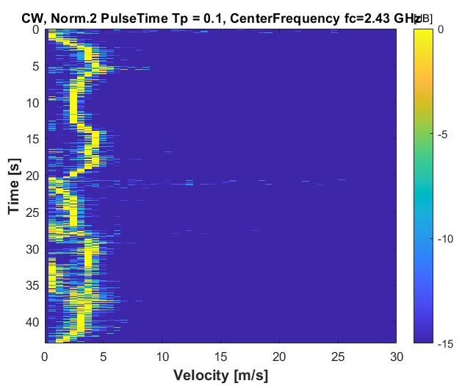
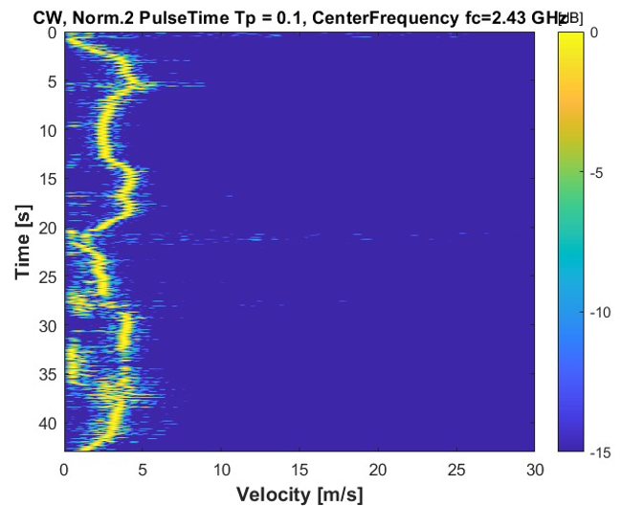
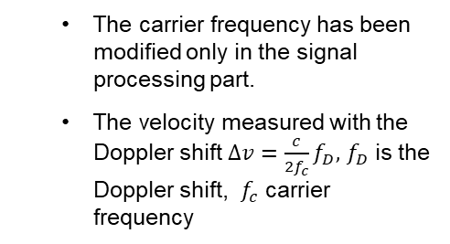
Variation of the Carrier frequency (fc) :
The carrier frequency has been modified only in the signal processing part.
The velocity measured with the Doppler shift $∆v=\frac{c}{{2f}_{c}}f_{D},$ $f_{D}$ is the Doppler shift, $f_{c}$ carrier frequency
Velocity[m/s]
Larger value carrier frequency
Lower value carrier frequency
Effect of the zero padding:
The zero padding is a useful tool to make the plots more readable . However, it is not able to increase the frequency resolution of our signal as that depends only on the window size Tp
No zero padding
Higher order zero padding (N=4)

Slide 4
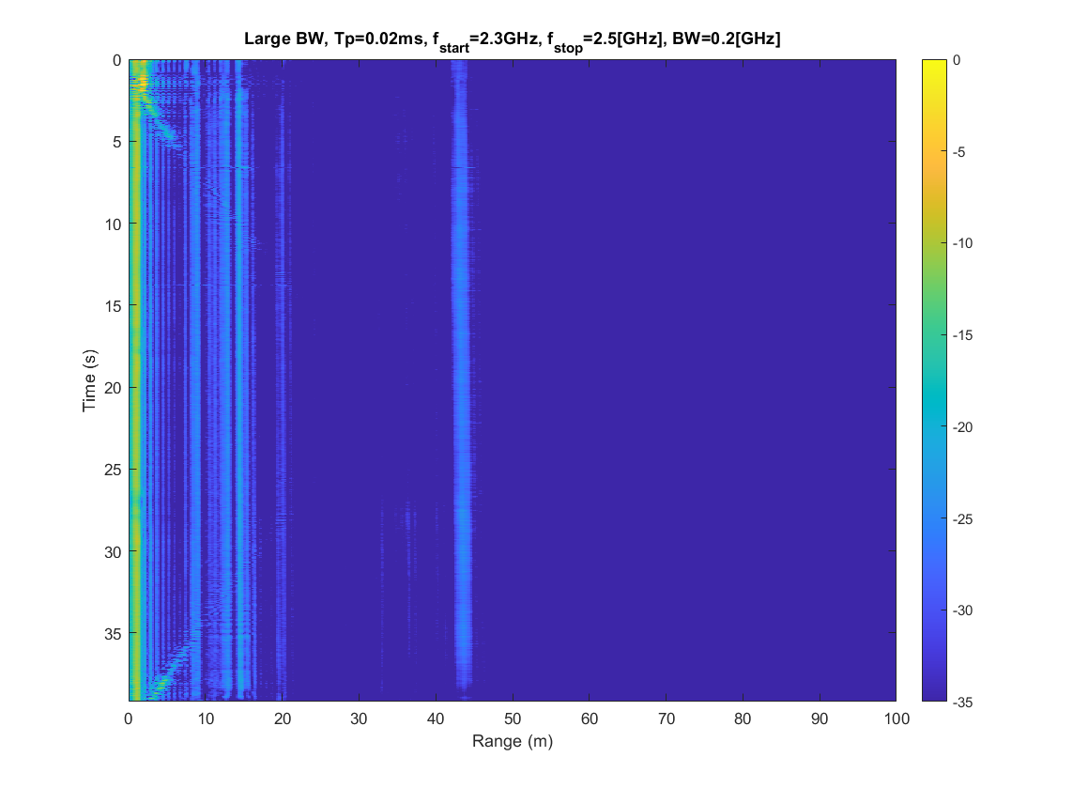
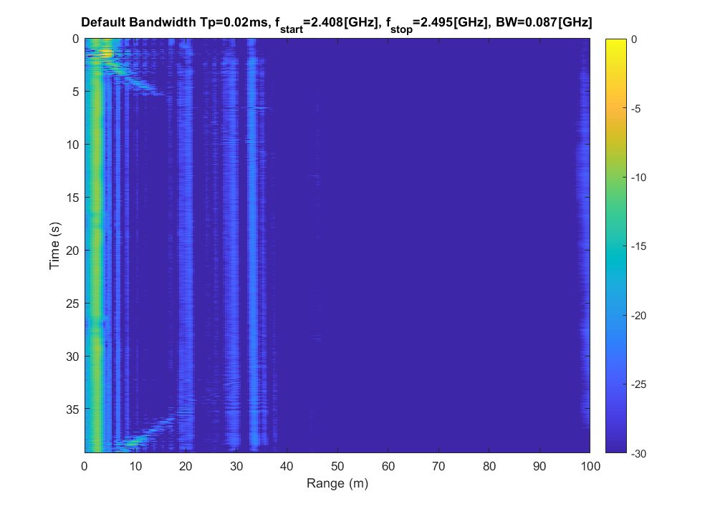
RANGE IMAGES FOR FMCW RADAR
Some important parameters to be considered for the range :
BW, FMCW bandwidth
fc carrier frequency
Sampling Frequency
Total Observation Time
Variation of the Bandwidth (BW) :
Larger bandwidth
Normal bandwidth
As the bandwidth is changed in the code (not in the actual transmitting wave) the effect is to change the scale factor of the range axis.

Slide 5
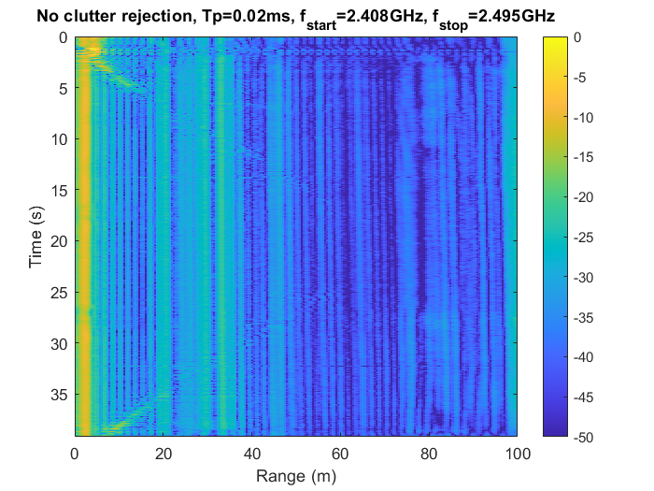
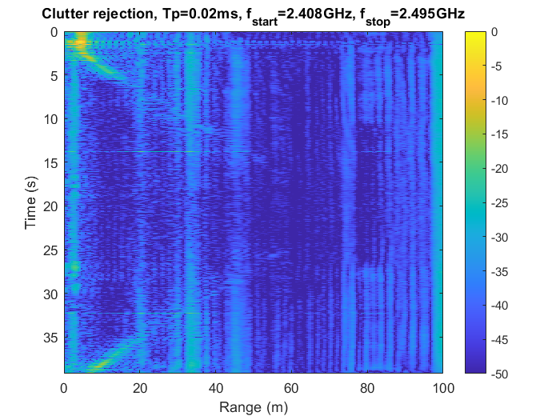
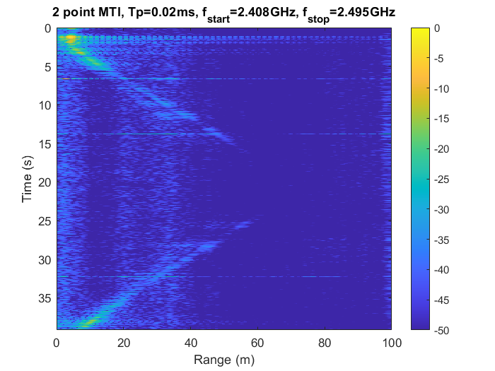
MS (Mean Subtraction) clutter rejection:
When the MS clutter rejection algorithm is added, its effect is to remove the background clutter. A significant improvement is generally obtained is as illustrated.
MS Subtract column mean to each column of the time domain matrix (before IFFT)
No MS clutter rejection
With MS clutter rejection
MTI (Moving Target Indicator) algorithm:
The MTI is used to filter out signals from stationary or slow-moving objects, enhancing the capability to differentiate moving targets by subtracting the current data from the previous one. No significant improvement were obtained with more-points MTI.
2 points MTI

Slide 6
CIRCUIT IMPLEMENTATION FOR SHORT RANGE RADAR AT 2.4 GHz
Marko Savić,
Giandomenico Panettieri

Slide 7
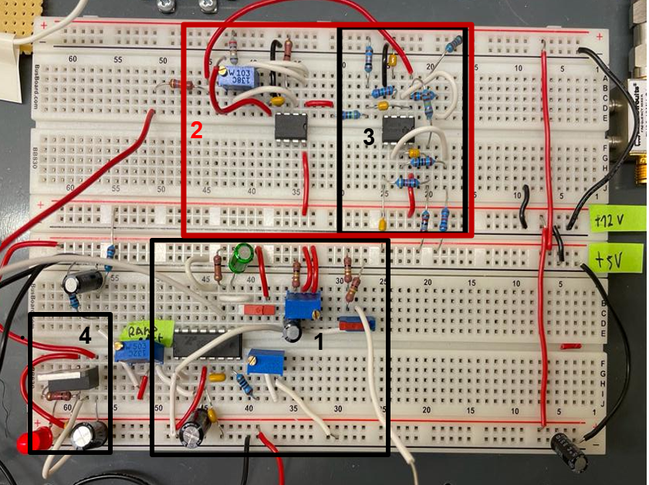
Commercial off-the-shelf radar circuit
2. Gain Amplifier
Gain trimmer
3. low-pass filter
DC offset of tuning voltage trimmer
4. voltage regulator
ramp magnitude trimmer
1. Modulator: square/triangle generator
Tp duration (chirp rate) trimmer

Slide 8
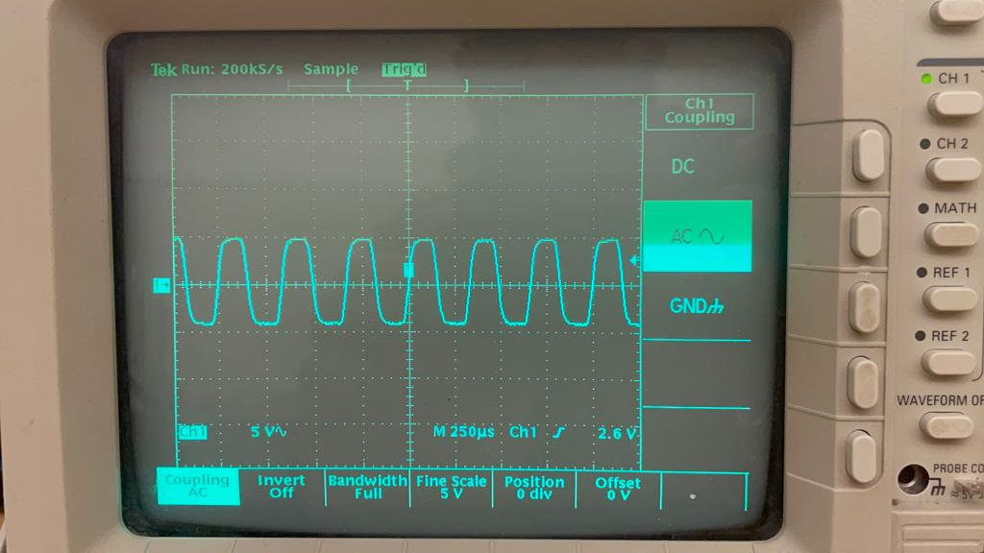
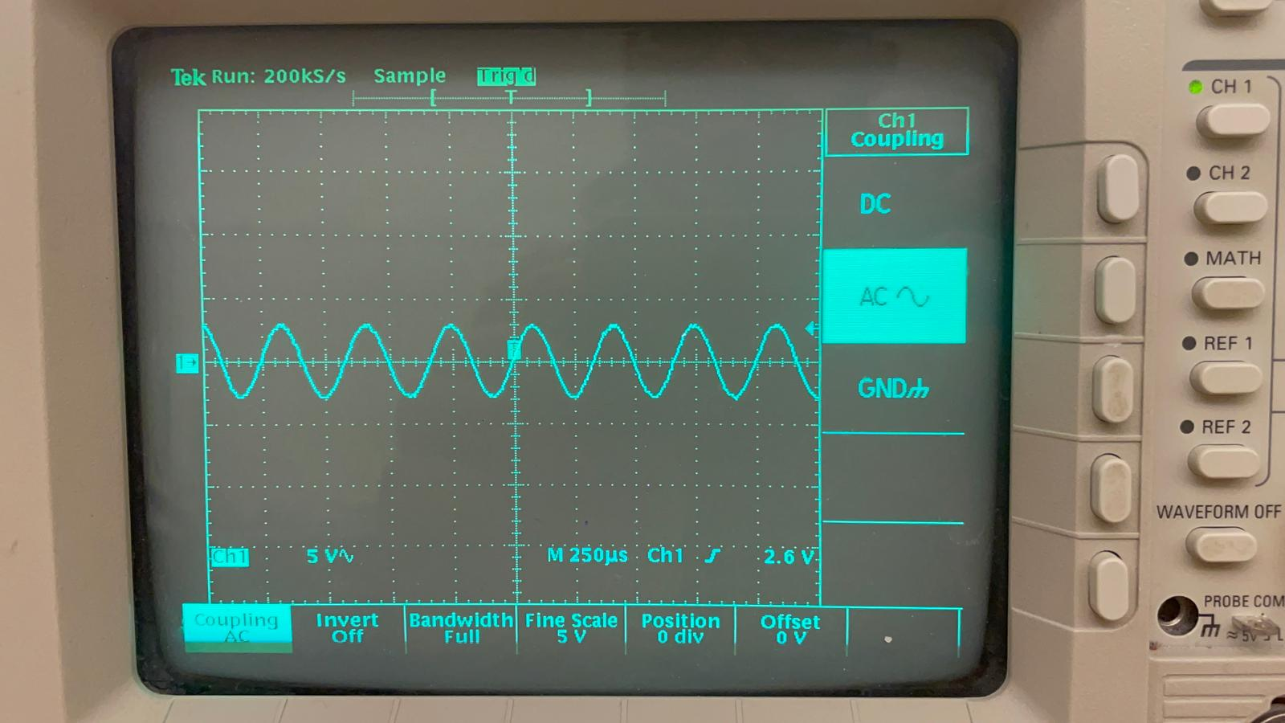
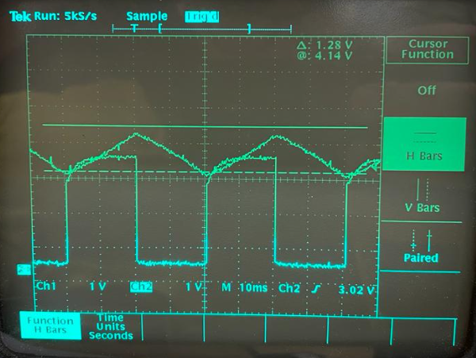
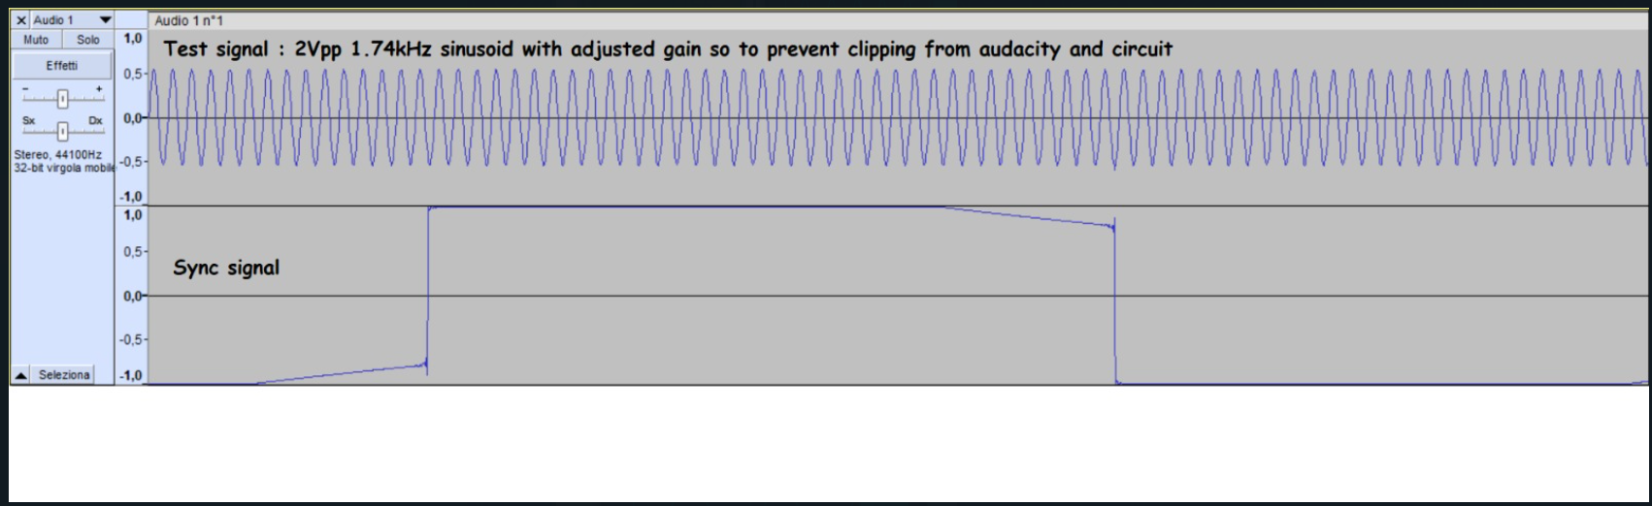
Circuit tuning and testing
clipping
no-clipping
Video-amplifier: the gain set so no clipping occurs, 2Vpp@1 .74kHz. Later, the gain will be adjusted based on the peak voltage of the received signal.
Modulator: Vpp = 2.2 to 3.4 V and up+down chirp period = 40 ms.
The chirp and the sync are synchronized!

Slide 9
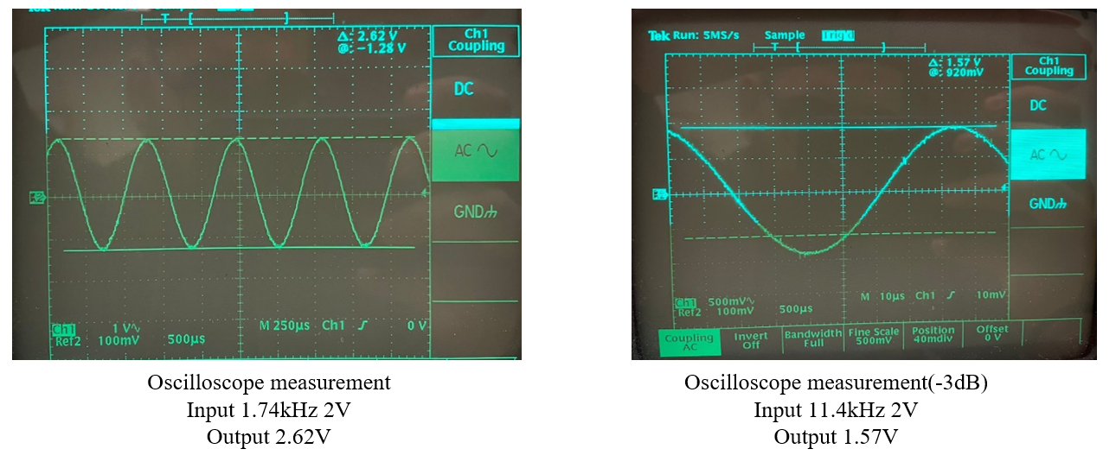
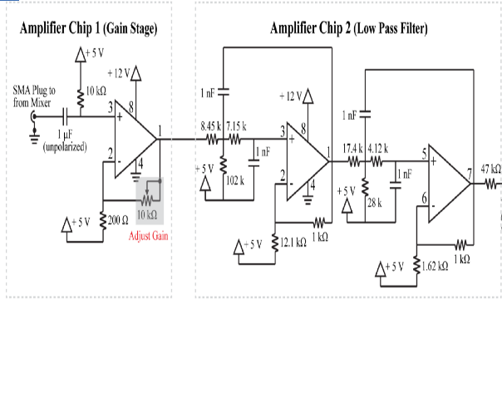
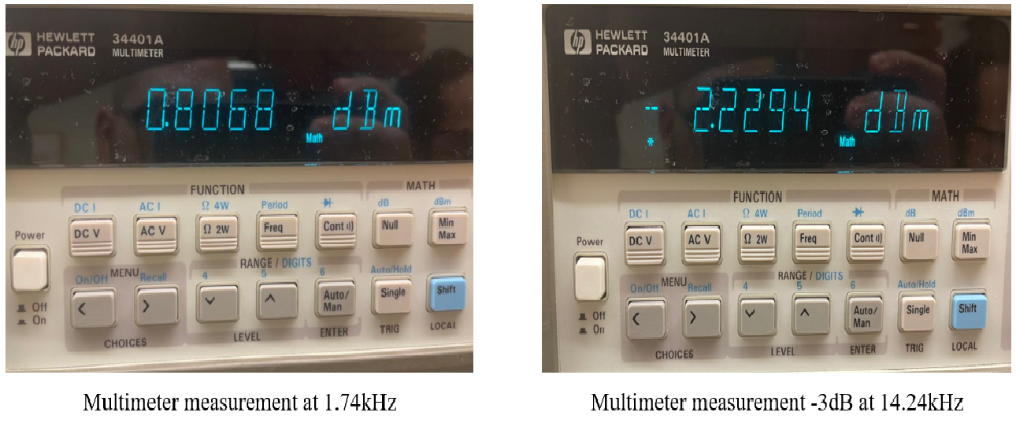
Video-amplifier -3dB point measurement
Two different frequencies are measured when probing at the circuit output, Why?
Probing point.
… seams like something is adding an additional pole…

Slide 10
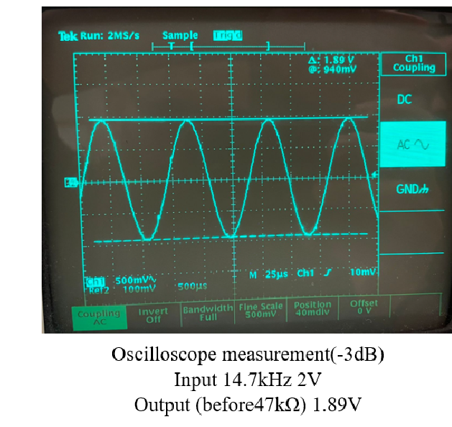
Video-amplifier -3dB point measurement
Probing point.
Probing the filter OpAmp output would short the reading capacitor of the oscilloscope to ground, resulting in no additional pole being introduced.
The measurements done with both the oscilloscope and the multimeter now match!

Slide 11
MEASUREMENTS WITH THE BUILT RADAR
Christian Giuseppe Terranova

Slide 12
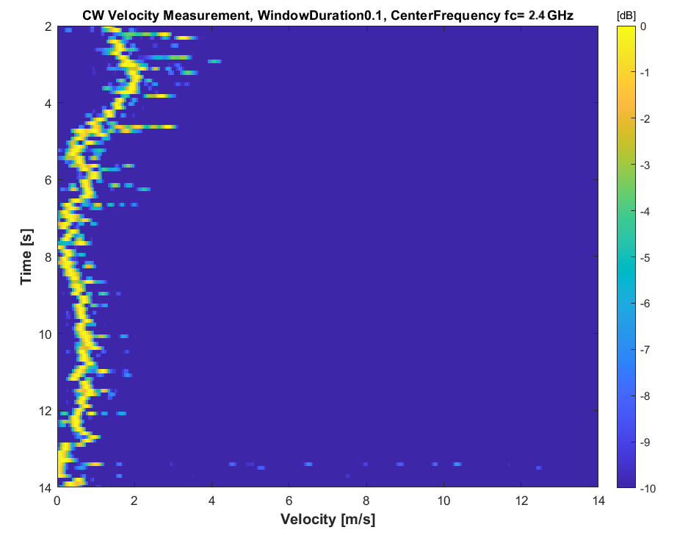
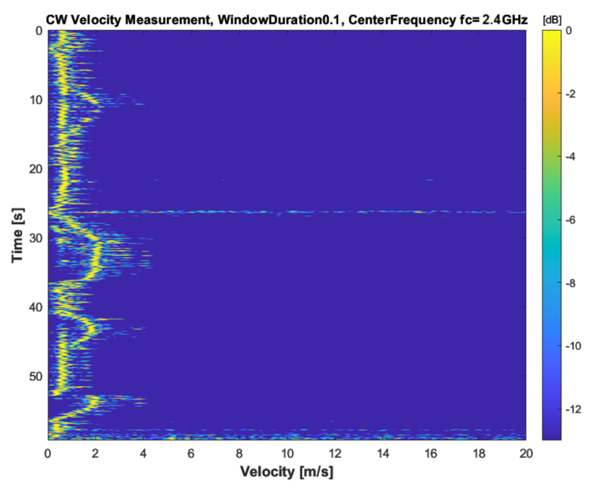
Velocity Measurements in CW mode
Single target measurement
Multiple targets measurement
Target with varying velocity covers the target with constant velocity when passing in front of the radar

Slide 13
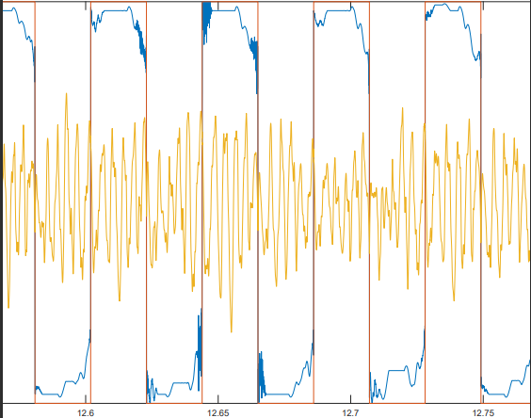
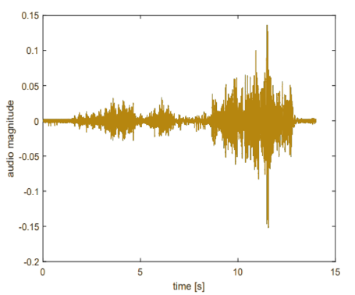
Range Measurements in FMCW mode
Time plot of data, sync and parsed sync
Received signal
Parsed sync
Received sync
Example of full received signal

Slide 14
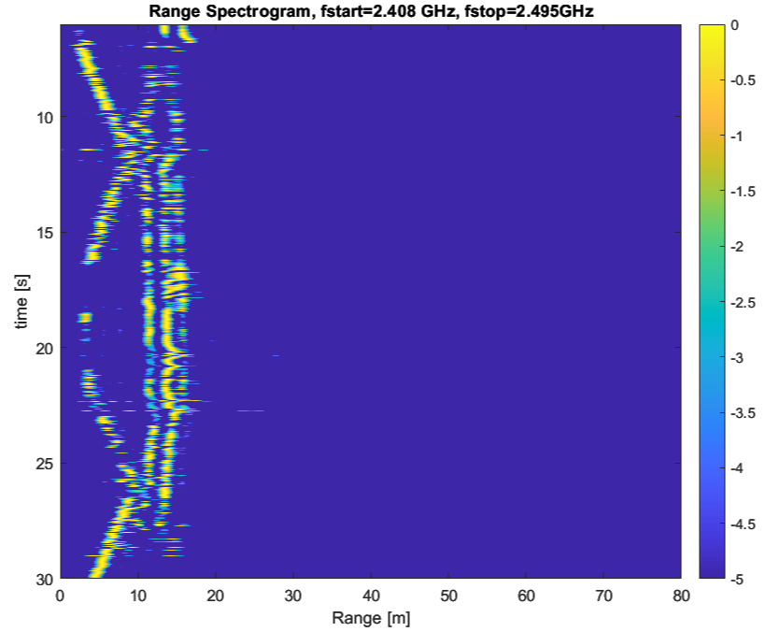
Range Measurements in FMCW mode
Range measurement for a single target
Moving target
Wall at ~14 meters

Slide 15
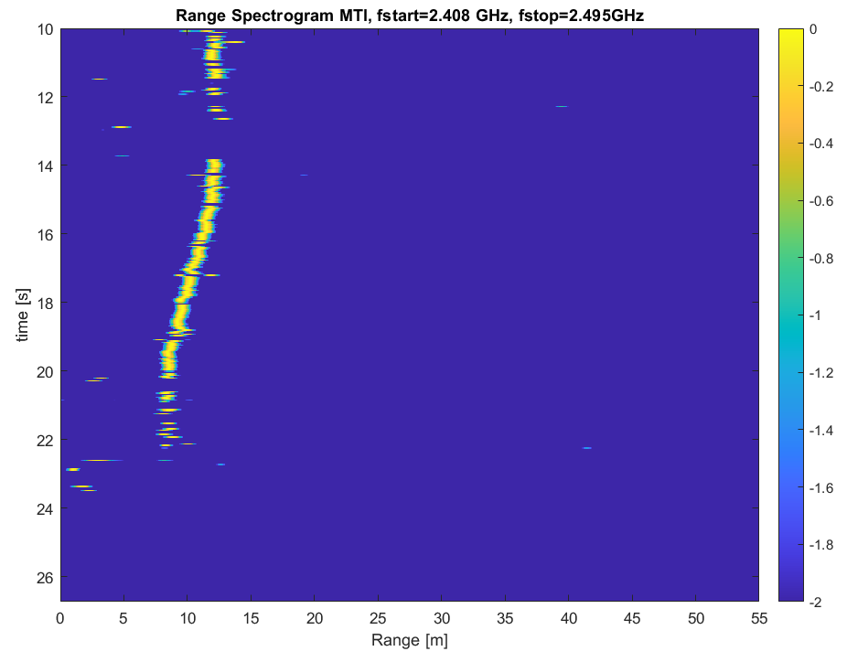
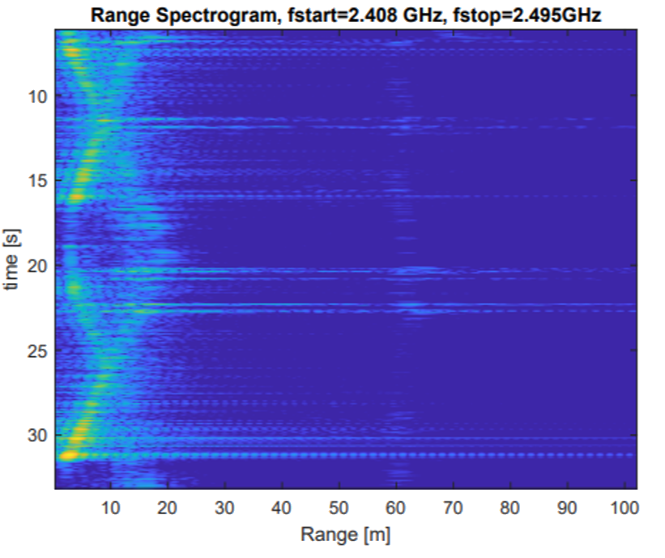
Range Measurements in FMCW mode
Single target with MTI
Multiple targets with MTI
MTI stands for Moving Target Indicator, it removes static objects from the scene.

Slide 16
SAR IMAGE SIGNAL PROCESSING AND MEASUREMENTS
Christian Giuseppe Terranova

Slide 17
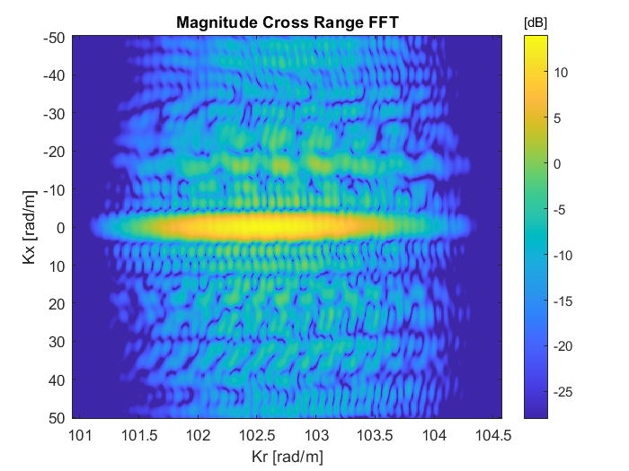
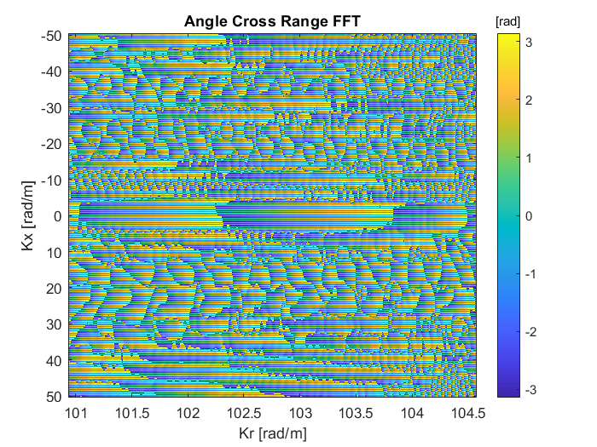
Range Migration Algorithm (RMA)
RMA consists of four steps:
1. Cross Range Fourier Transform: calculate the FFT of the spatial components resulting to a magnitude and phase plot.
2. Matched Filter: correlate a known signal (template) with an unknown signal to detect the template presence.

Slide 18
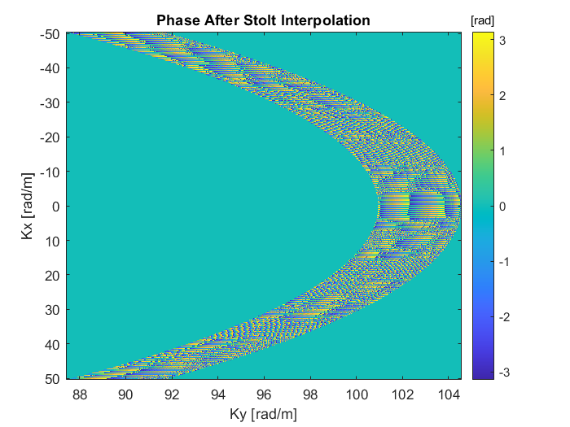
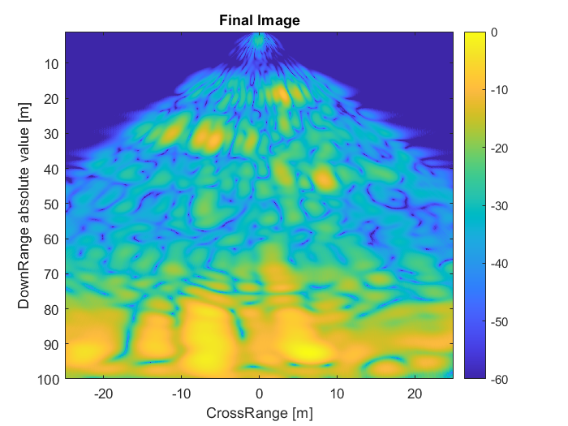
Range Migration Algorithm (RMA)
3. Stolt Interpolation: Transforms the 2-D SAR data from the range spatial frequency and azimuth frequency domain into the wavenumber domain.
4. IFFT: Converts the Stolt interpolation into an image.

Slide 19
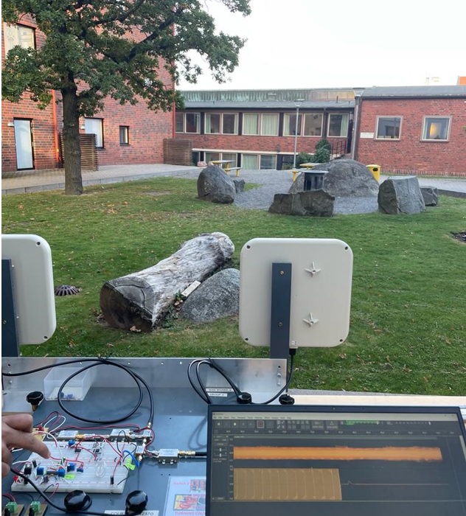
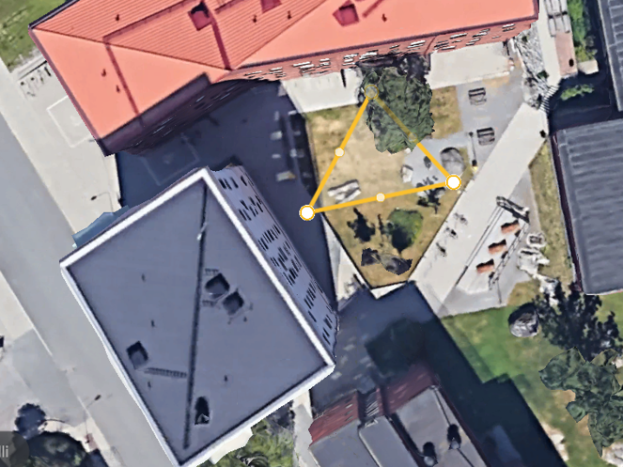
SAR Test on a landscape
Group view of the landscape
Satellite image of the same landscape
Cone considered in the code

Slide 20
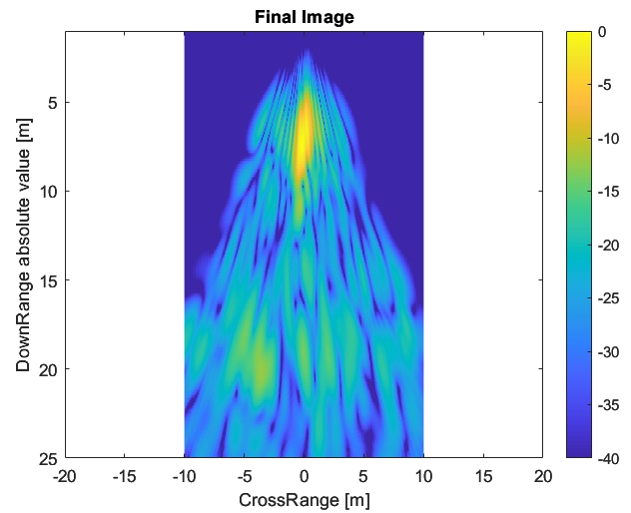
SAR Test on a landscape
Resulting SAR image
Comparison with the landscape

Slide 21
Software Defined Radio at 5.8 GHz
Marko Savić
Job Mattew George
Giandomenico Panettieri

Slide 22
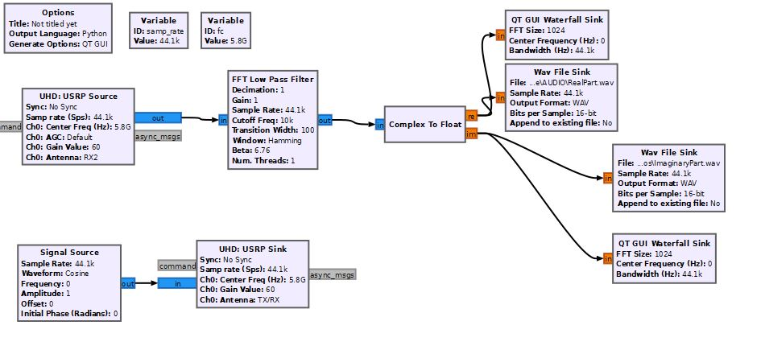
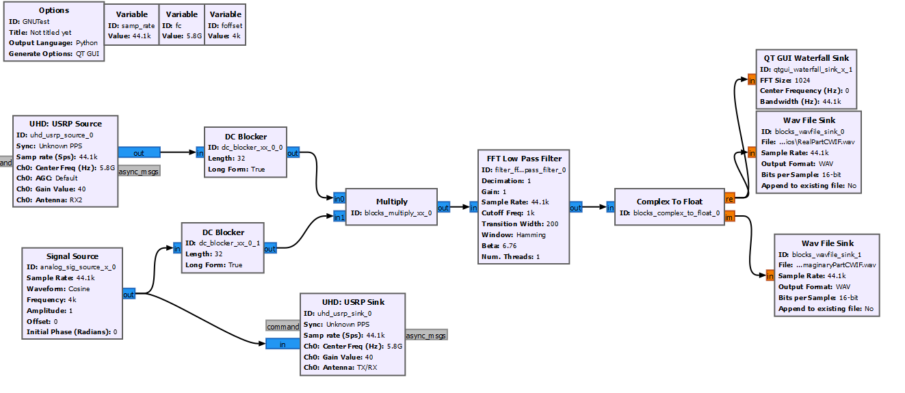
GNU Radio schematics
CW radar
Low IF-CW radar
Lock-in Amp.

Slide 23
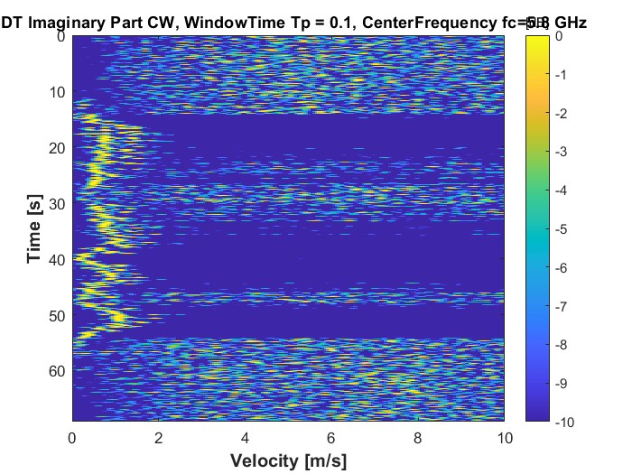
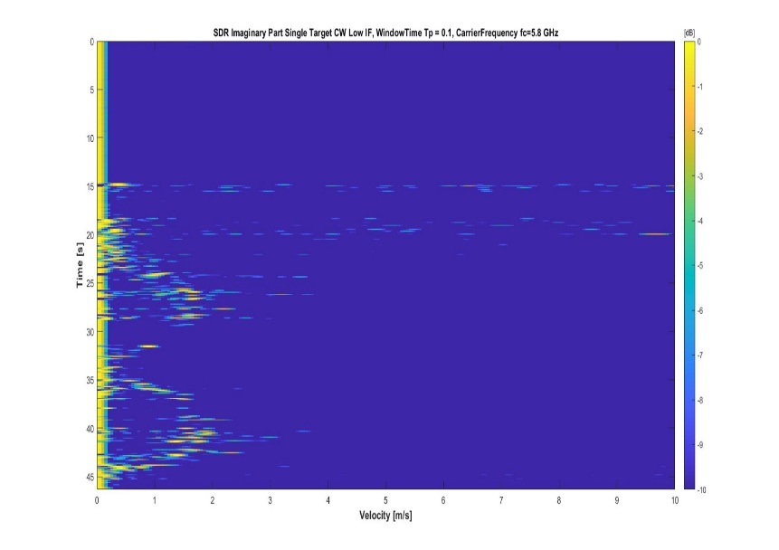
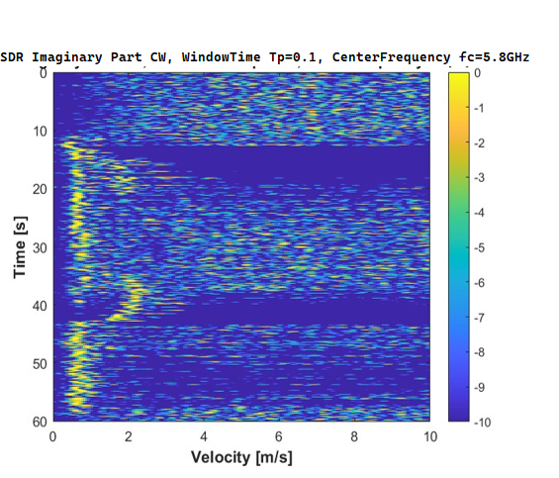
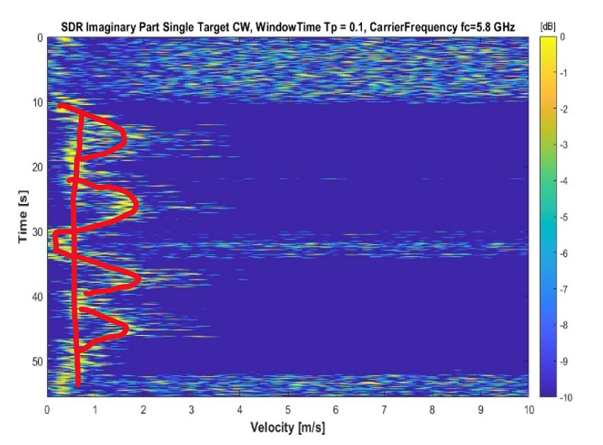
Velocity measurement
Target: a person
CW single target
Low IF-CW single target
CW multiple target
Low IF-CW multiple target

Slide 24
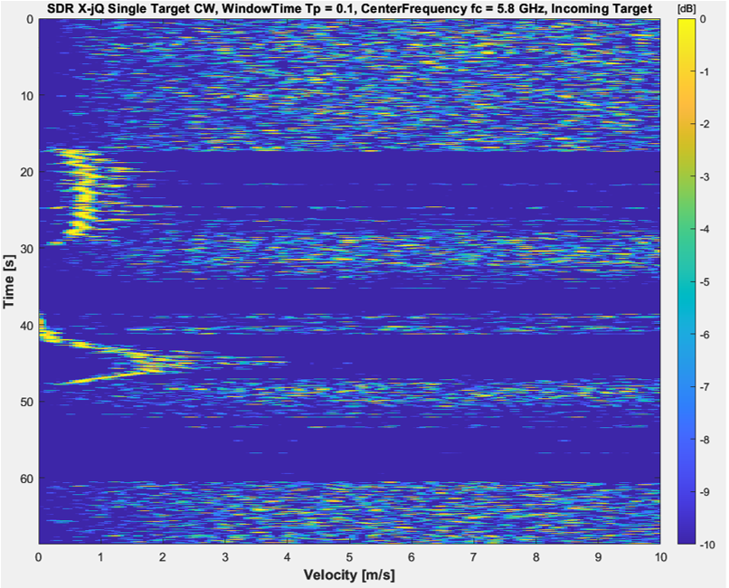
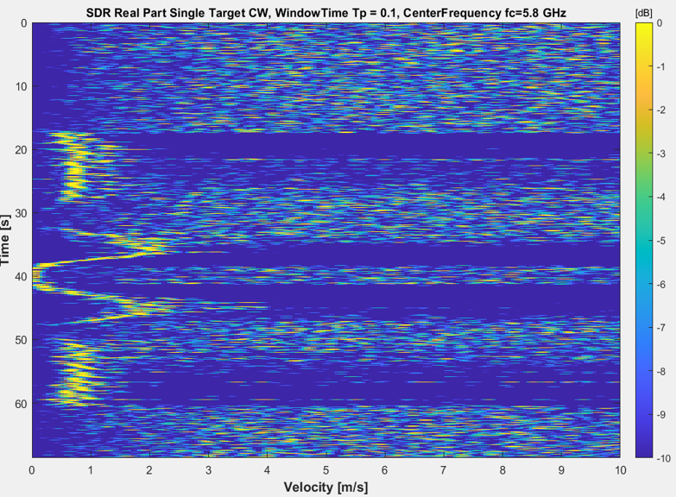
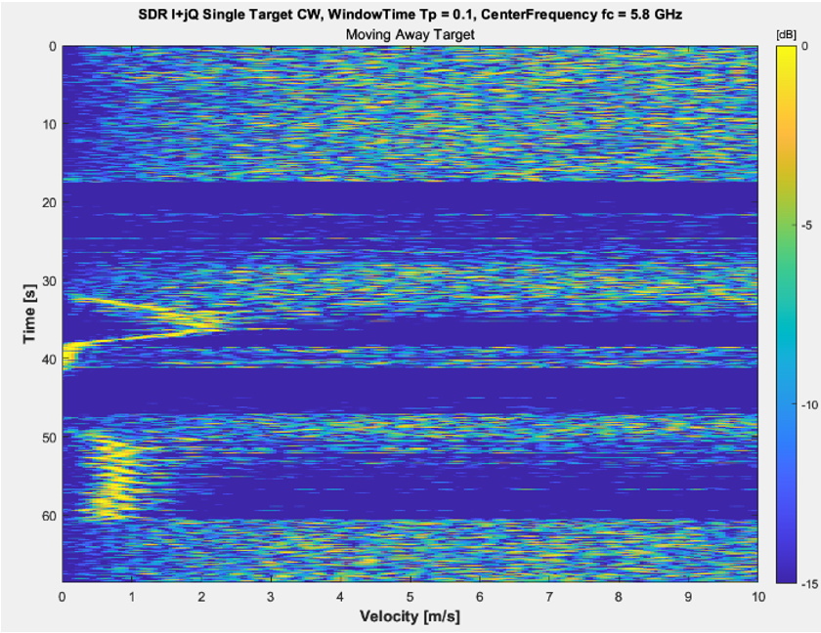
Velocity direction
I − jQ provides the velocity of a target that is moving toward
Velocity magnitude
Using QM modulation, it is possible to process the in-phase (symbol I ) and the quadrature phase signal (symbol Q).
I + jQ provides the velocity of a target that is moving away

Slide 25
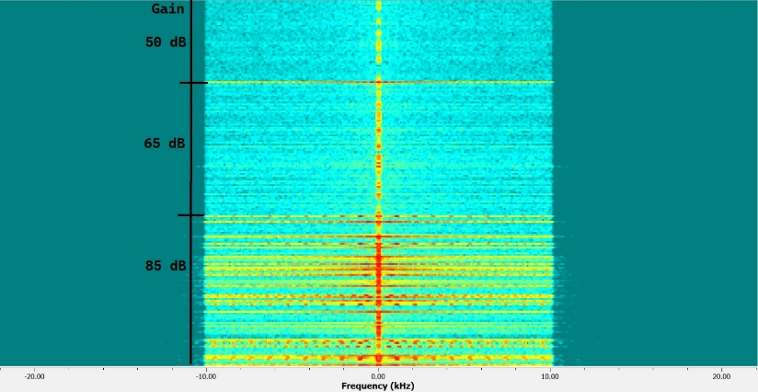
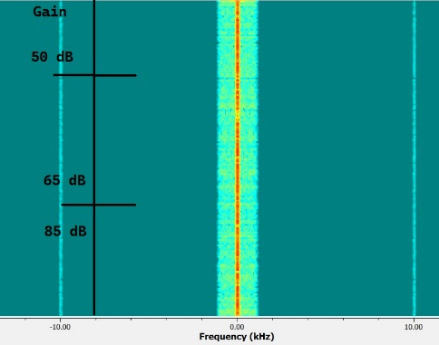
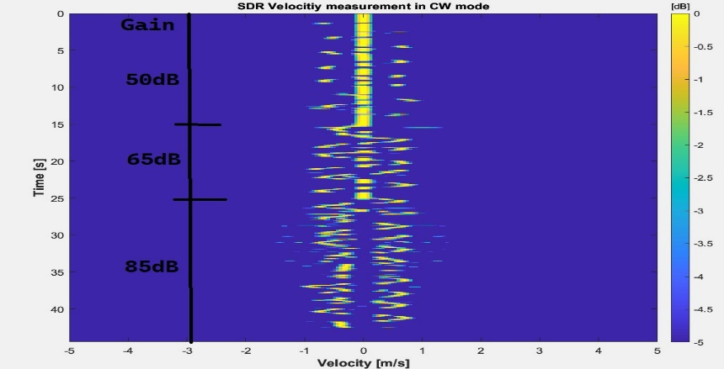
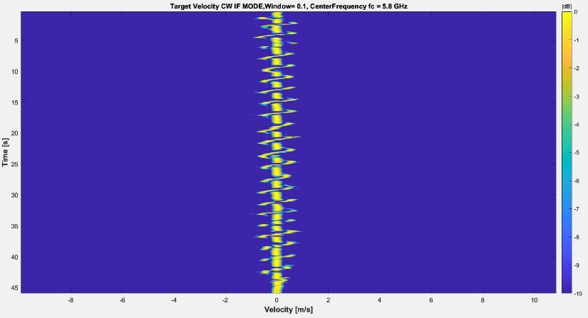
Velocity measurement with power amplifier
Is it the LO leakage or absolute output power which is the limiting factor?
CW
Target: a human hand
Low IF-CW
saturation of amplifiers
Self-mixing LO creates a strong DC component at baseband. This saturates the subsequent stages making the signal distorted.
When the radar operates in Low IF CW mode this problem is mitigated since the wanted signal after down-conversion is not near DC.

Slide 26
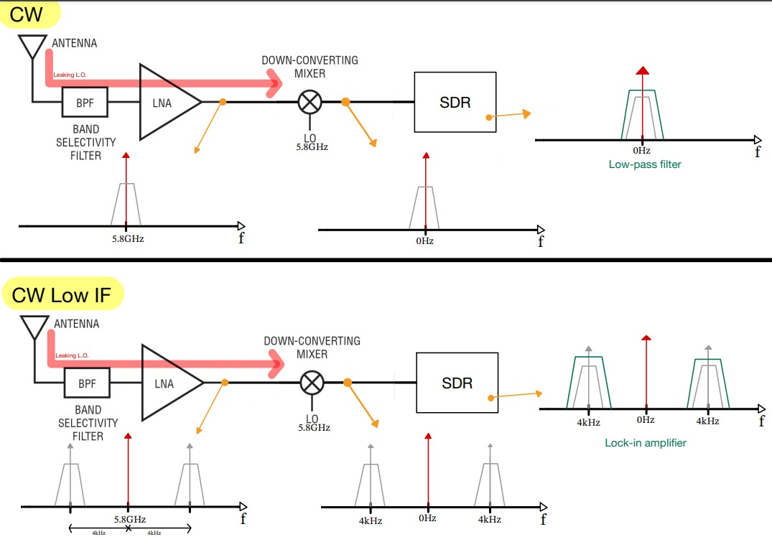
What is going on?
Due to the L.O. leakage, the received signal has also a strong 5.8GHz component in both CW and Low IF CW cases
When down-converted in CW mode, the powerful unwanted signal falls completely in the signal bandwidth, causing severe distortion.
In the CW Low IF mode, the signal and the unwanted signal are separated.

Slide 27
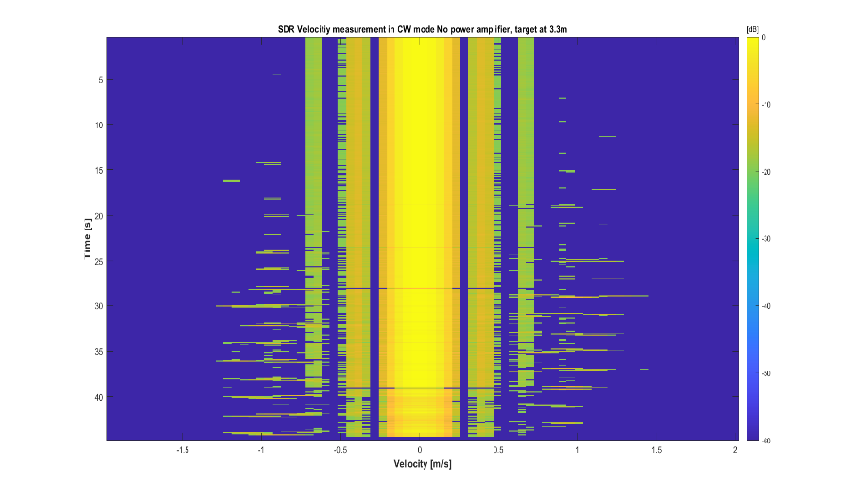
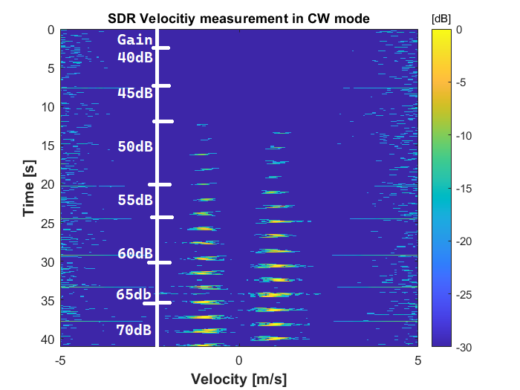



CW Range measurement of a moving hand
Target: a human hand
With power amp.
Without power amp.
High- pass filter
Why phase noise has a bad
Impact on low frequency
signals?
Signal with sufficient SNR can be seen
Phase noise overcomes the signal

Slide 28






Heart rate and breathing pattern
The phase difference between the I and the Q signals contains information about the range variation of the target. $R(t)=c/(4πf_{c})φ(t)$
Target is moving
its chest (order of
millimeters!)
Peak at around 1Hz ~ heart rate
The signal that we are trying to recover is located near 0.2Hz
In CW mode, due to phase noise, it is impossible to recover the signal
In Low IF CW mode, the signal is perfectly visible!

